Slide 1

Apex Institute of Technology
Department of Computer Science & Engineering
Bachelor of Engineering (Computer Science & Engineering)
Design and Analysis of Algorithms– (21CSH-282)
Prepared By: Mr. Vikas Kumar (E13657)
DISCOVER . LEARN . EMPOWER

Slide 2
Content
Algorithm performance analysis: Time complexity
Space complexity

Slide 3
Performance Analysis:
There are many Criteria to judge an algorithm.
– Is it correct?
– Is it readable?
– How it works
Performance evaluation can be divided into two major phases.
1. Performance Analysis (machine independent)
space complexity: The space complexity of an algorithm is the amount of memory it needs to run for completion.
time complexity: The time complexity of an algorithm is the amount of computer time it needs to run to completion.

Slide 4
Performance Analysis:
2. Performance Measurement (machine dependent).
Space Complexity:
The Space Complexity of any algorithm P is given by S(P)=C+SP(I),C is constant.
1.Fixed Space Requirements (C)
Independent of the characteristics of the inputs and outputs
– It includes instruction space
– space for simple variables, fixed-size structured variable, constants
2. Variable Space Requirements (SP(I))
Depending on the instance characteristic I
– number, size, values of inputs and outputs associated with I
– recursive stack space, formal parameters, local variables, return address

Slide 5
Reasons for estimating the time complexity
The reasons for estimating the time complexity of the program even before running the program for the first time are:
We need real-time responses for many applications. That is a faster execution of the program is required for many applications.
If the time complexity is estimated beforehand, then modifications can be done to the program to improve its performance before running it.
It is used to specify the upper limit for the time of execution for some programs. The purpose of this is to avoid infinite loops.

Slide 6
Complexity Factor
The time complexity of the program depends on the following factors:
• Compiler used – some compilers produce optimized code which consumes less time to get executed.
• Compiler options – The optimization options can be set in the options of the compiler.
• Target computer – The speed of the computer or the number of instructions executed per second differs from one computer to another.

Slide 7
Examples:
Program 1 :Simple arithmetic function
Algorithmabc( a, b, c)
{
return a + b + b * c + (a + b - c) / (a + b) + 4.00;
}
SP(I)=0
HenceS(P)=Constant

Slide 8
Examples:
Program 2: Iterative function for sum a list of numbers
Algorithm sum( list[ ], n)
{
tempsum = 0;
for i = 0 ton do
tempsum += list [i];
return tempsum;
}

Slide 9
Examples:
Program 3: Recursive function for sum a list of numbers
Algorithmrsum( list[ ], n)
{
If (n<=0) then
return 0.0
else
return rsum(list, n-1) + list[n];
}

Slide 10
Methods to compute the step count:
1) Introduce variable count into programs
2) Tabular method
1) Introduce variable count into programs
Determine the total number of steps contributed by each statement
step per execution frequency
add up the contribution of all statements

Slide 11
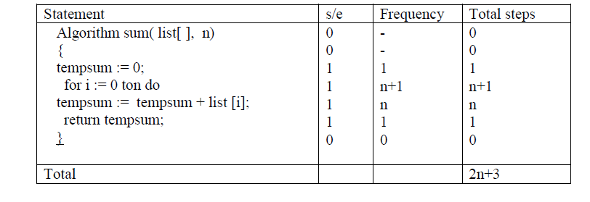
Methods to compute the step count
2)Tabular methods.
Complexity is determined by using a table that includes steps per execution(s/e) i.e
Amount by which the count changes as a result of the execution of the statement.
Frequency – number of times a statement is executed

Slide 12
TASKS END OF LECTURE LEARNING (TELL):

Slide 13
TASKS END OF LECTURE LEARNING (TELL):

Slide 14
References
Fundamentals of Computer Algorithms 2nd Edition (2008) by Horowitz, Sahni and Rajasekaran
Introduction to Algorithms 3rd Edition (2012) by Thomas H Cormen, Charles E Lieserson, Ronald

Slide 15
THANK YOU
For queries
Email: vikash.e13657@cumail.in

